Slide 1
The A-Team
IMDb Movie Genre Classification

Slide 2
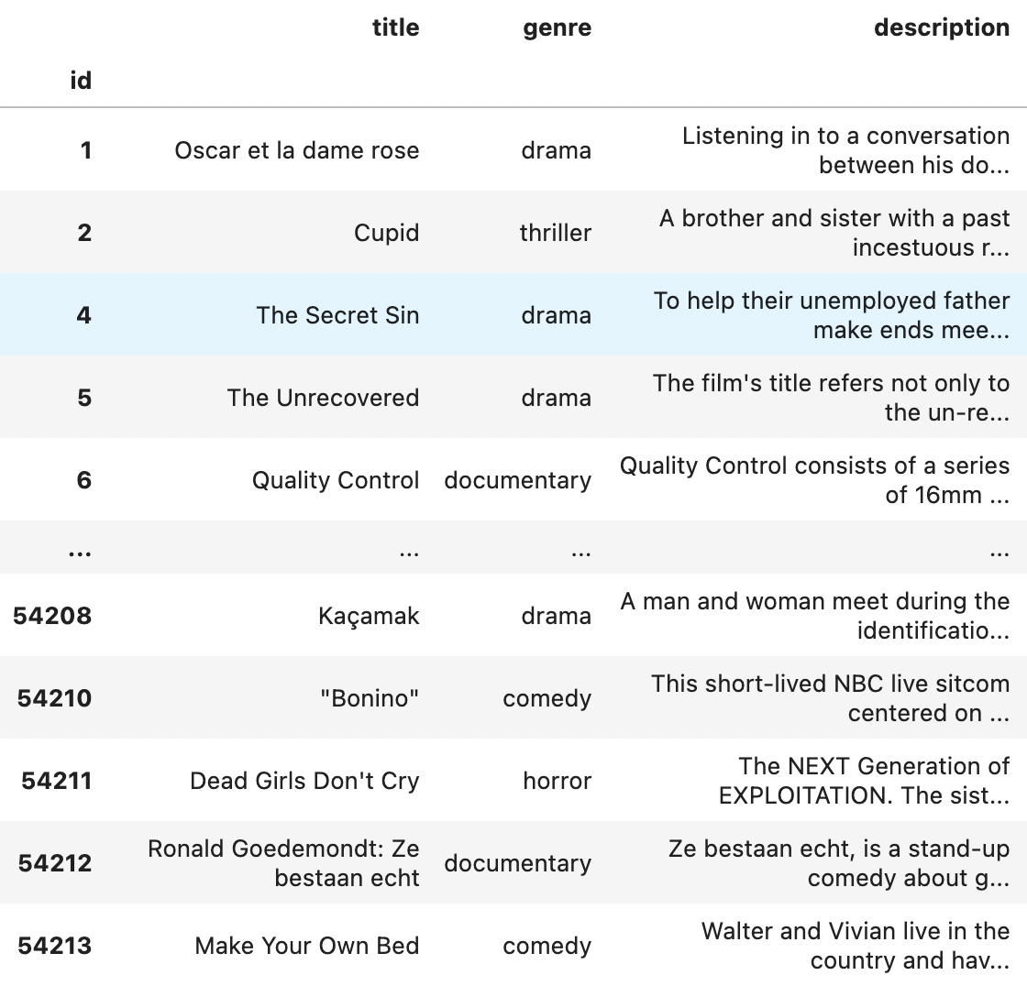
Overview
Movie Genre Classification
IMDb Dataset from Kaggle
Best accuracy on Kaggle: 64.5%
Our best accuracy: 57%
Best accuracy on top-7: 74%
Hard problem, since there is a large overlap between genres.
Notes:
Ak
We created a DS pipeline to classify the genre of a movie from its description.
Used IMDB dataset.
Best performance - 64.5. `
A lot of movies have multiple genres, making it hard to classify into a single genre.

Slide 3
Feature Engineering
Removed stopwords
Removed punctuation
Stemmed / tokenized text descriptions
Stemming Example:
Programming → Program
Liked → Like
Notes:
Josh
Explain what stopwords are
Why stemming? → helps model by reducing the number of word variations (so it understands all forms of each word as the same word, rather than different words)

Slide 4
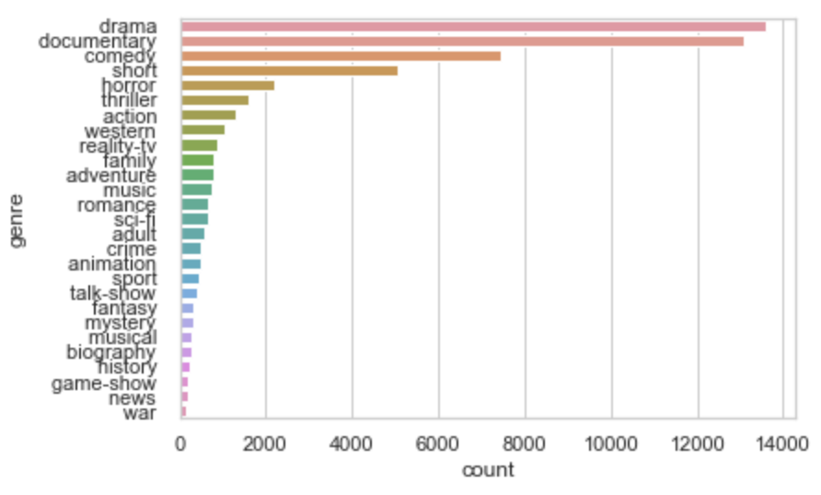
Exploratory Data Analysis
Genre Distribution
Notes:
Milind

Slide 5
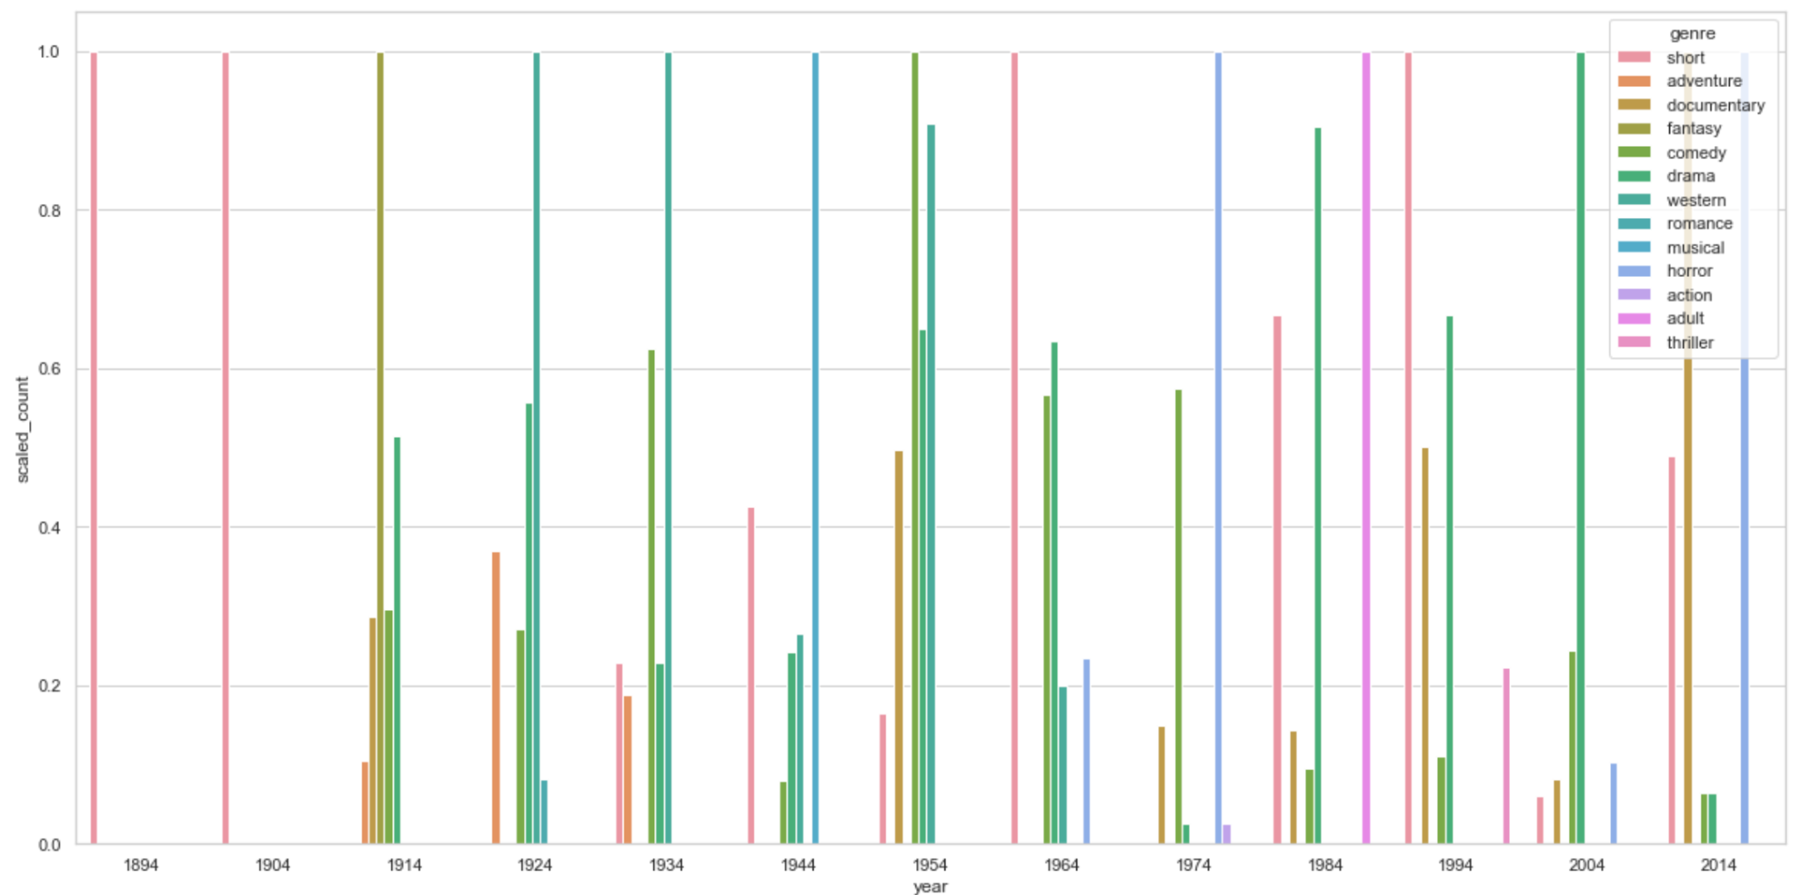
Exploratory Data Analysis
Genre Counts Over Time
Notes:
Milind

Slide 6
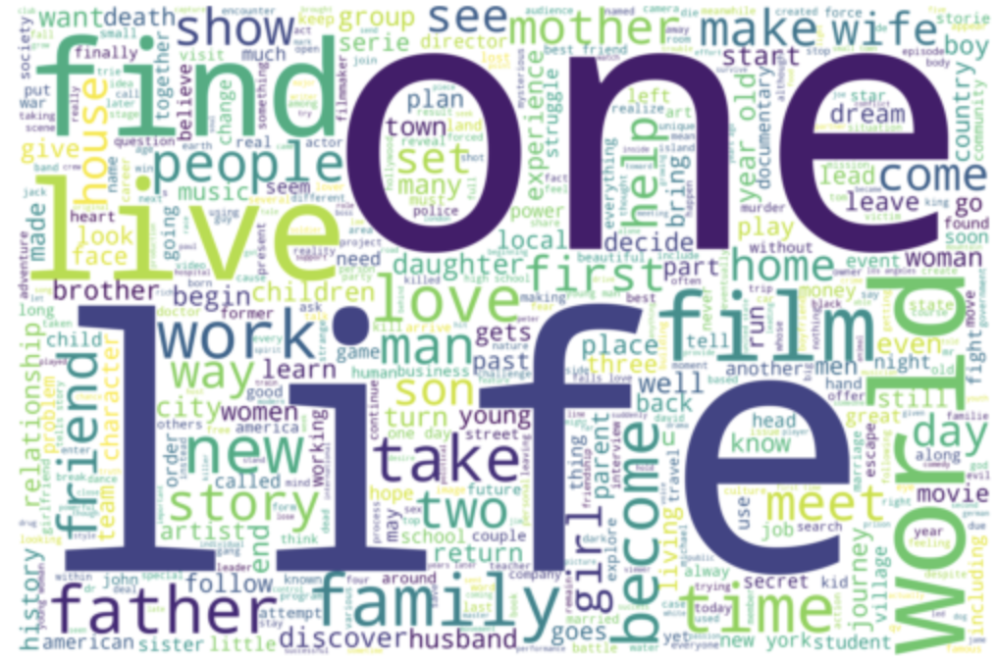
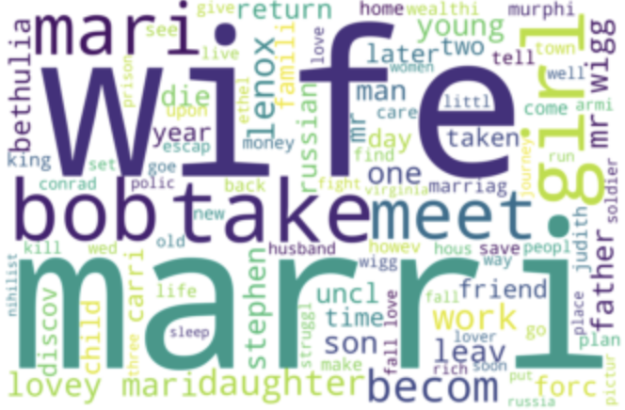
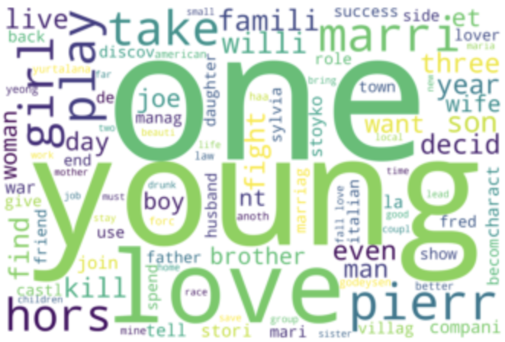
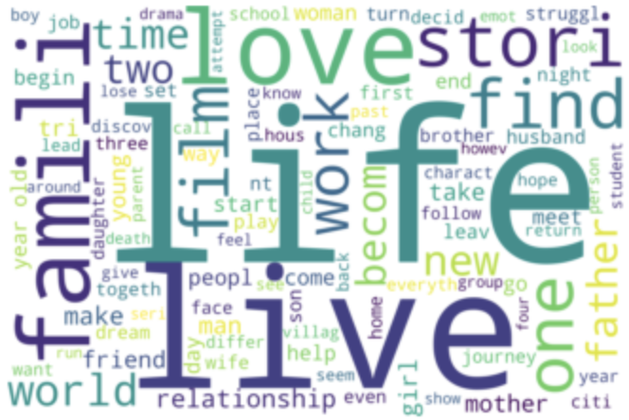
Exploratory Data Analysis
Frequent words in movie descriptions…
Descriptions for drama over the years…
Year 1914 Year 1954 Year 2014
Notes:
Milind

Slide 7
Exploratory Data Analysis
English | 53831
French | 147
Italian | 115
Spanish | 44
Hungarian | 38
German | 18
Norwegian | 16
Albanian | 1
Danish | 1
Dutch | 1
Japanese | 1
Portuguese | 1
Not all movie descriptions are in English.
Filter dataset by using a pretrained language identification model like FastText.
Notes:
Ak
Noticed some descriptions in other languages.
Checked it by using FastText.
Small amount of data not in english.
Considered to be outliers. Not considered for our assessment.

Slide 8
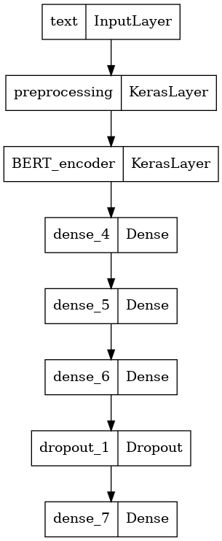
Models
Vanilla Neural Network: Hidden layer sizes - (128, 256, 256, 128)
Gated Recurrent Unit (GRU): An embedding layer followed by a GRU layer
Long Short-Term Memory (LSTM): An embedding layer followed by an LSTM layer
TF-IDF:
Naive Bayes
Random Forest
Small BERT: Transformer based model (bert_en_uncased_L-2_H-128_A-2) followed by dense NN (128, 256, 256).
Notes:
Ak
Noticed some descriptions in other languages.
Checked it by using FastText.
Small amount of data not in english.
Considered to be outliers. Not considered for our assessment.

Slide 9
Handling Class Imbalance
Random Oversampling
Sample all classes but the majority class.
Notes:
Millind

Slide 10
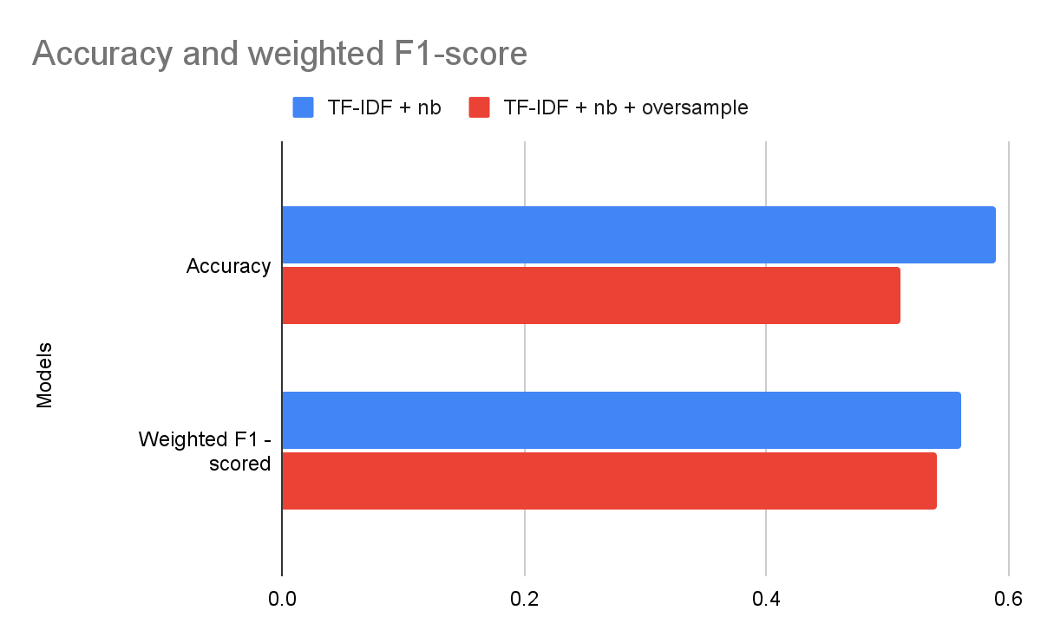
Effects of Oversampling
Notes:
Millind

Slide 11
Handling Class Imbalance
Random Oversampling
Sample all classes but the majority class.
Reducing the number of genres
Remove ‘short’
Retain only top-7 genres
Remove ‘thriller’
Notes:
Josh

Slide 12
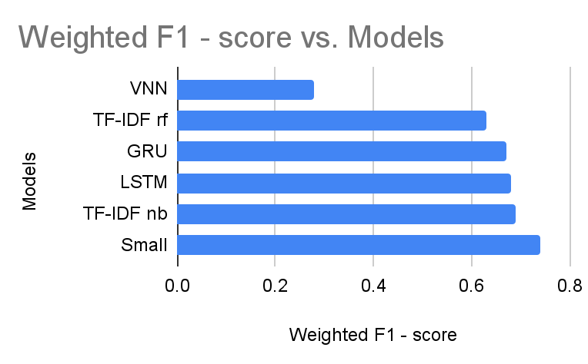
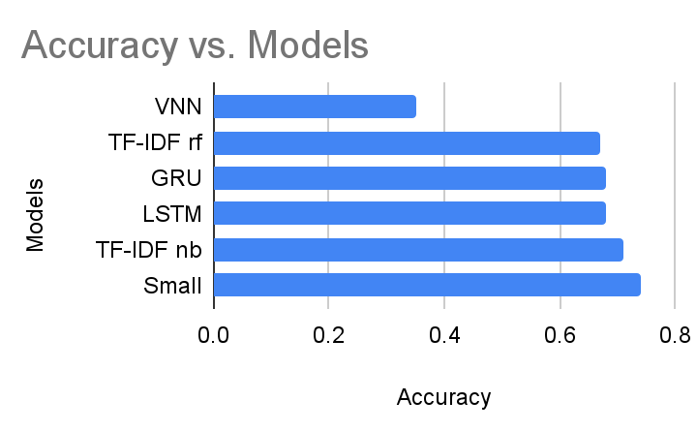
Model Performance (Aggregated)
Notes:
Ak
Performance metrics.
Vanilla
Random Forest
Naive Bayes.

Slide 13
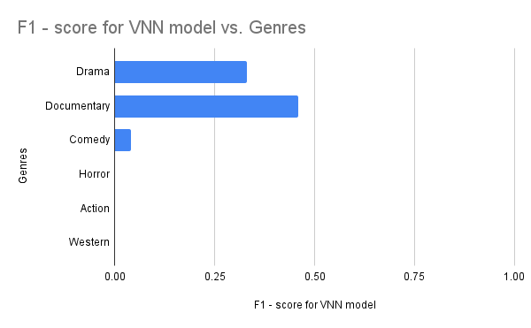
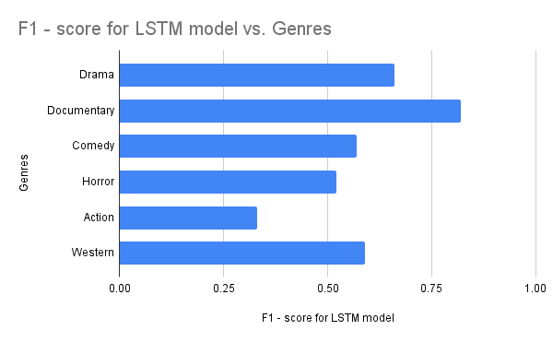
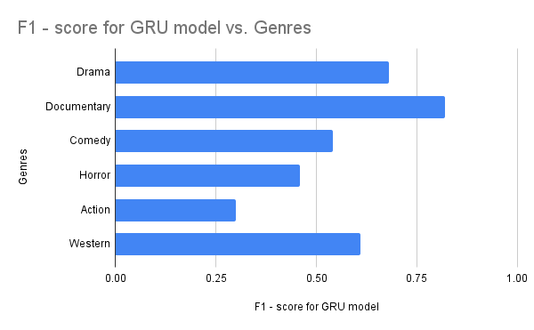
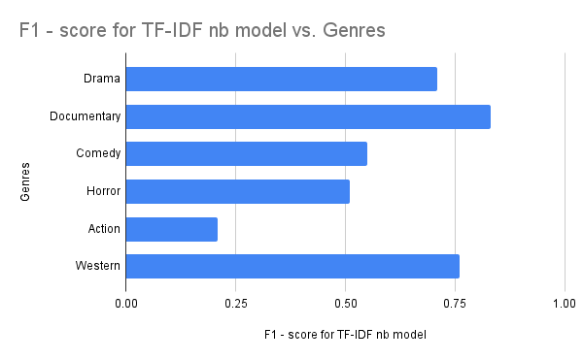
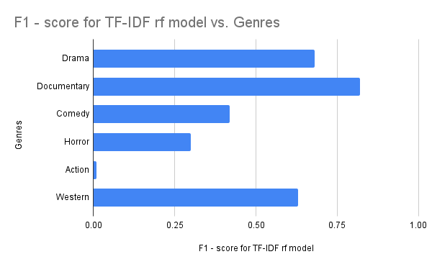
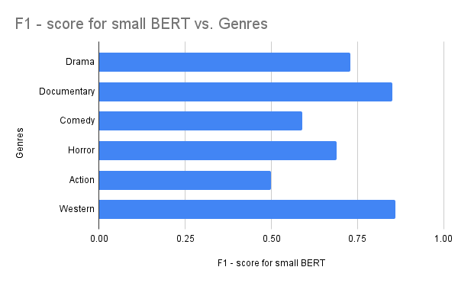
Model Performance by Genre
Notes:
Kushal
The Vanilla Neural Net performed abysmally and ended up predicting the majority classes.
The LSTM and GRU models performed averagely but were bad at predicting minority classes, especially action.
TF-IDF models had high accuracies but a bad performance at predicting minority classes.
Small BERT is the most well rounded model.
(we did compute several other metrics like confusion matrices as well but did not present them due to shortage of time)

Slide 14
Demo
Notes:
Kushal

Slide 15
Thank You

